Slide 1
Student Performance Clustering

Slide 2
Agenda
1. Data Understanding
  Read data
  Random Data Sample
  Size of Data
  Information of Data
  Check Names of Columns
  Check Description
  Number of Unique Columns
  Check Balance of Data

Slide 3
Agenda
2. Data Cleaning
  Check for missing Values
  Detect and drop duplicate rows
  Check Outliers

Slide 4
Dataset

Slide 5
Dataset
Feature | Description | Data Type
school | Student’s school (GP = Gabriel Pereira, MS = Mousinho da Silveira) | Categorical
sex | Student’s gender (F = female, M = male) | Categorical
age | Student’s age (15–22) | Numeric (int)
address | Type of home address (U = urban, R = rural) | Categorical
famsize | Family size (LE3 = ≤3, GT3 = >3) | Categorical
Pstatus | Parent’s cohabitation status (T = together, A = apart) | Categorical
Medu | Mother’s education (0 = none → 4 = higher) | Numeric (ordinal)
Fedu | Father’s education (0 = none → 4 = higher) | Numeric (ordinal)
Mjob | Mother’s job (teacher, health, services, etc.) | Categorical
Fjob | Father’s job (teacher, services, other, etc.) | Categorical
reason | Reason for choosing school (home, reputation, etc.) | Categorical
guardian | Student’s guardian (mother, father, other) | Categorical
traveltime | Home-to-school travel (1 = <15 min → 4 = >1 hr) | Numeric (ordinal)
studytime | Weekly study time (1 = <2h → 4 = >10h) | Numeric (ordinal)
failures | Past class failures (0–3, 4 = ≥4) | Numeric (int)

Slide 6
Dataset
Feature | Description | Data Type
schoolsup | Extra educational support (yes/no) | Boolean
famsup | Family educational support (yes/no) | Boolean
paid | Extra paid classes (yes/no) | Boolean
activities | Extra-curricular activities (yes/no) | Boolean
nursery | Attended nursery school (yes/no) | Boolean
higher | Aspires to higher education (yes/no) | Boolean
internet | Internet access at home (yes/no) | Boolean
romantic | In a romantic relationship (yes/no) | Boolean
famrel | Family relationship quality (1–5) | Numeric (ordinal)
freetime | Free time after school (1–5) | Numeric (ordinal)
goout | Going out with friends (1–5) | Numeric (ordinal)
Dalc | Workday alcohol consumption (1–5) | Numeric (ordinal)
Walc | Weekend alcohol consumption (1–5) | Numeric (ordinal)
health | Current health status (1–5) | Numeric (ordinal)
absences | Number of school absences | Numeric (int)
G1 | First period grade (0–20) | Numeric (int)
G2 | Second period grade (0–20) | Numeric (int)
G3 | Final grade (target, 0–20) | Numeric (int)

Slide 7
Data Understanding

Slide 8
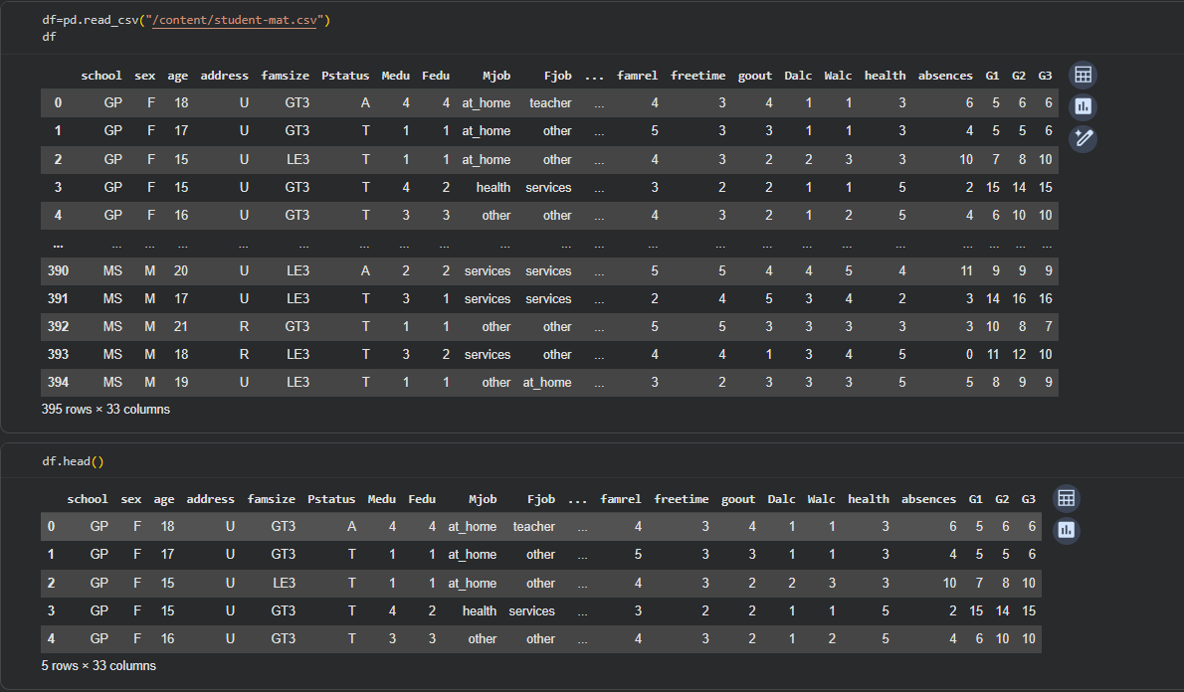
Read Data

Slide 9
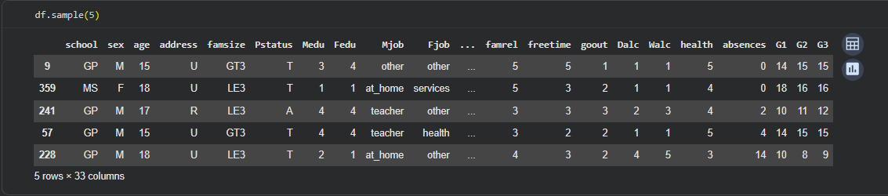
Random Sample of Data

Slide 10
Size of Data

Slide 11
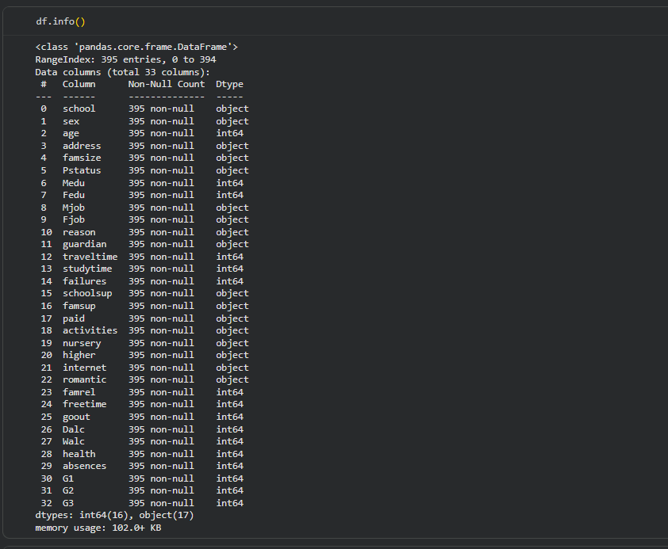
Information of Data

Slide 12
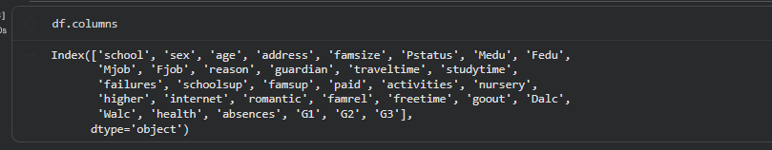
Check Names of Columns

Slide 13
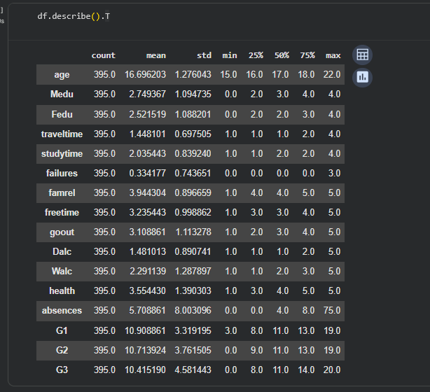
Check Description

Slide 14
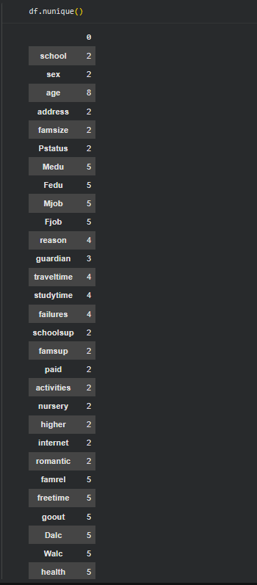
Number of Unique Columns

Slide 15
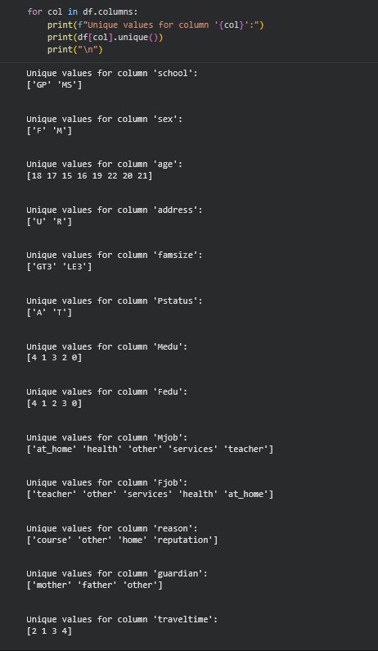
Number of Unique Columns

Slide 16
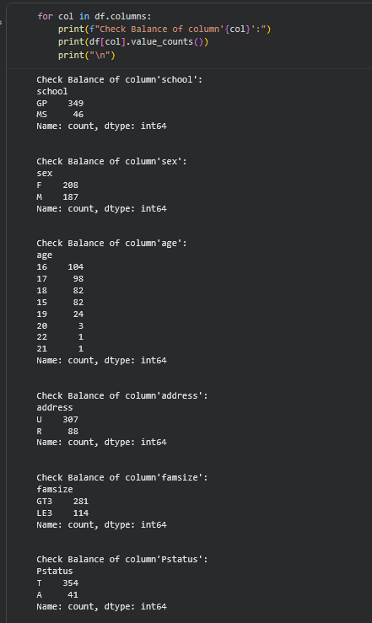
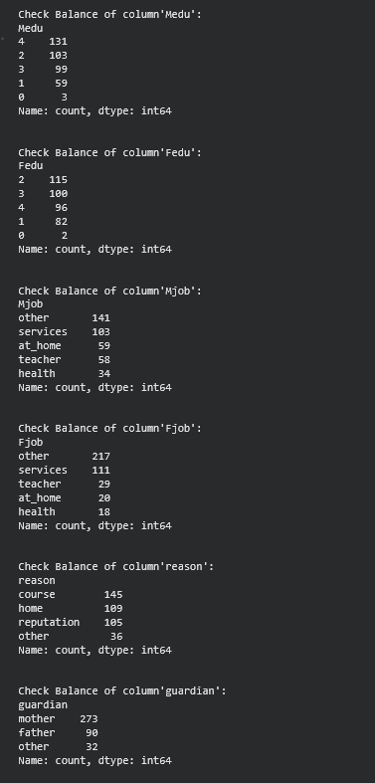
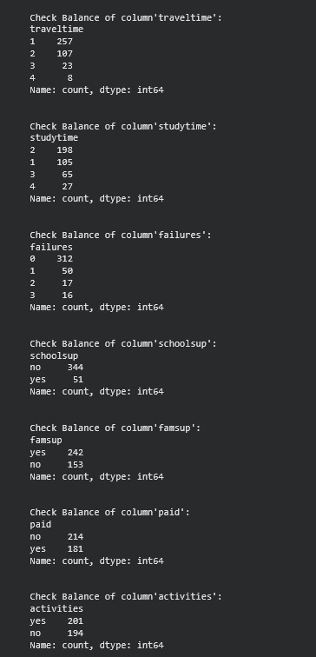
Check Balance of Data

Slide 17
Data Cleaning

Slide 18
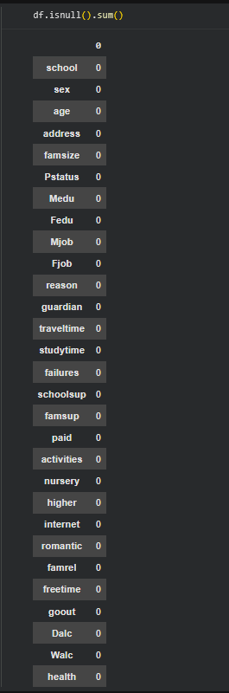
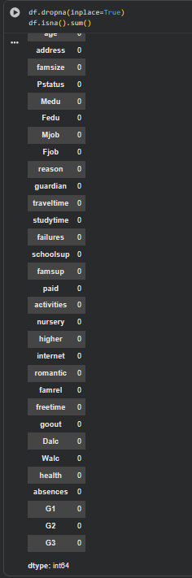
Check for Missing Values

Slide 19
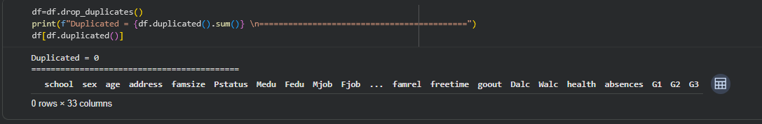
Detect and Drop Duplicate Rows

Slide 20
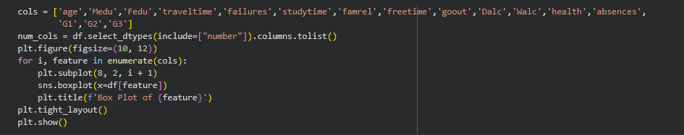
Check Outliers

Slide 21
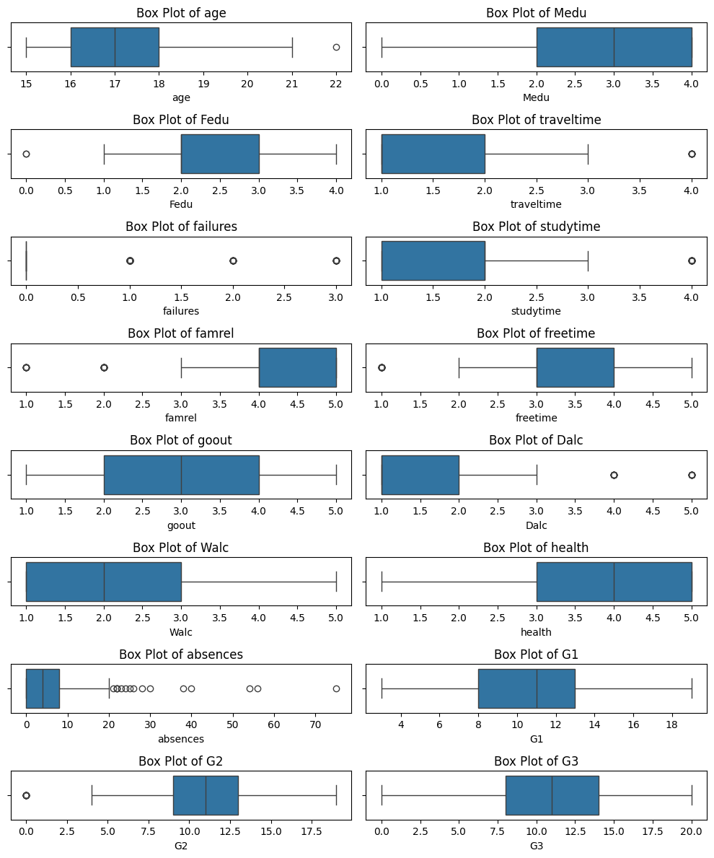
Check Outliers

Slide 22
Data Overview

Slide 23
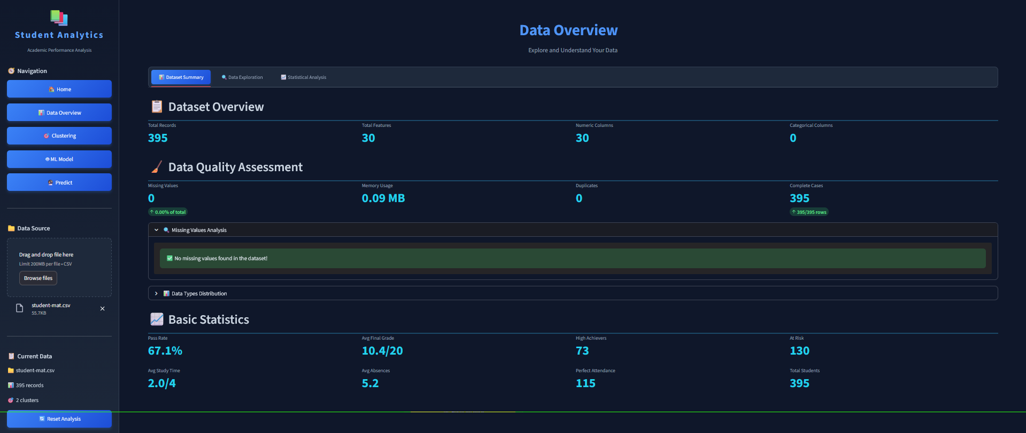

Slide 24
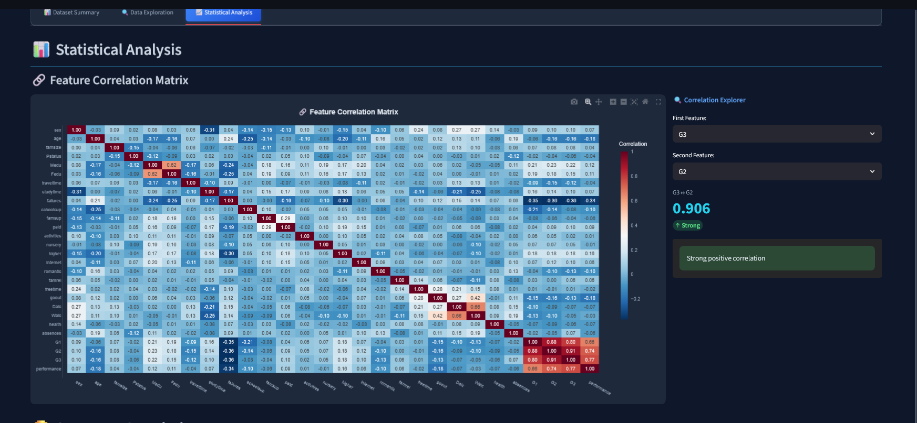

Slide 25
Clustering

Slide 26
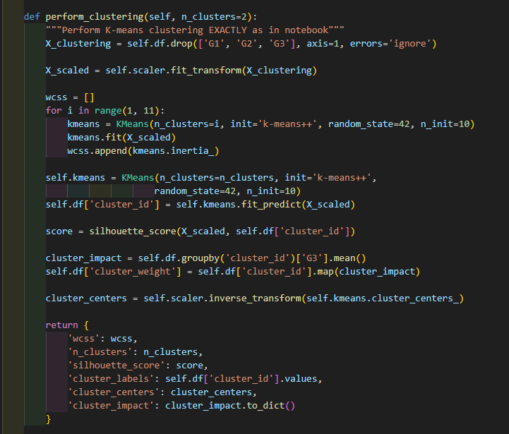
Clustering Methodology
Exclude grades (G1, G2, G3) for pure behavioral clustering
Standardize features using StandardScaler
Use K-Means with k-means++ initialization
Apply elbow method to determine optimal clusters
Calculate silhouette score for validation
Create cluster_weight feature based on average G3

Slide 27
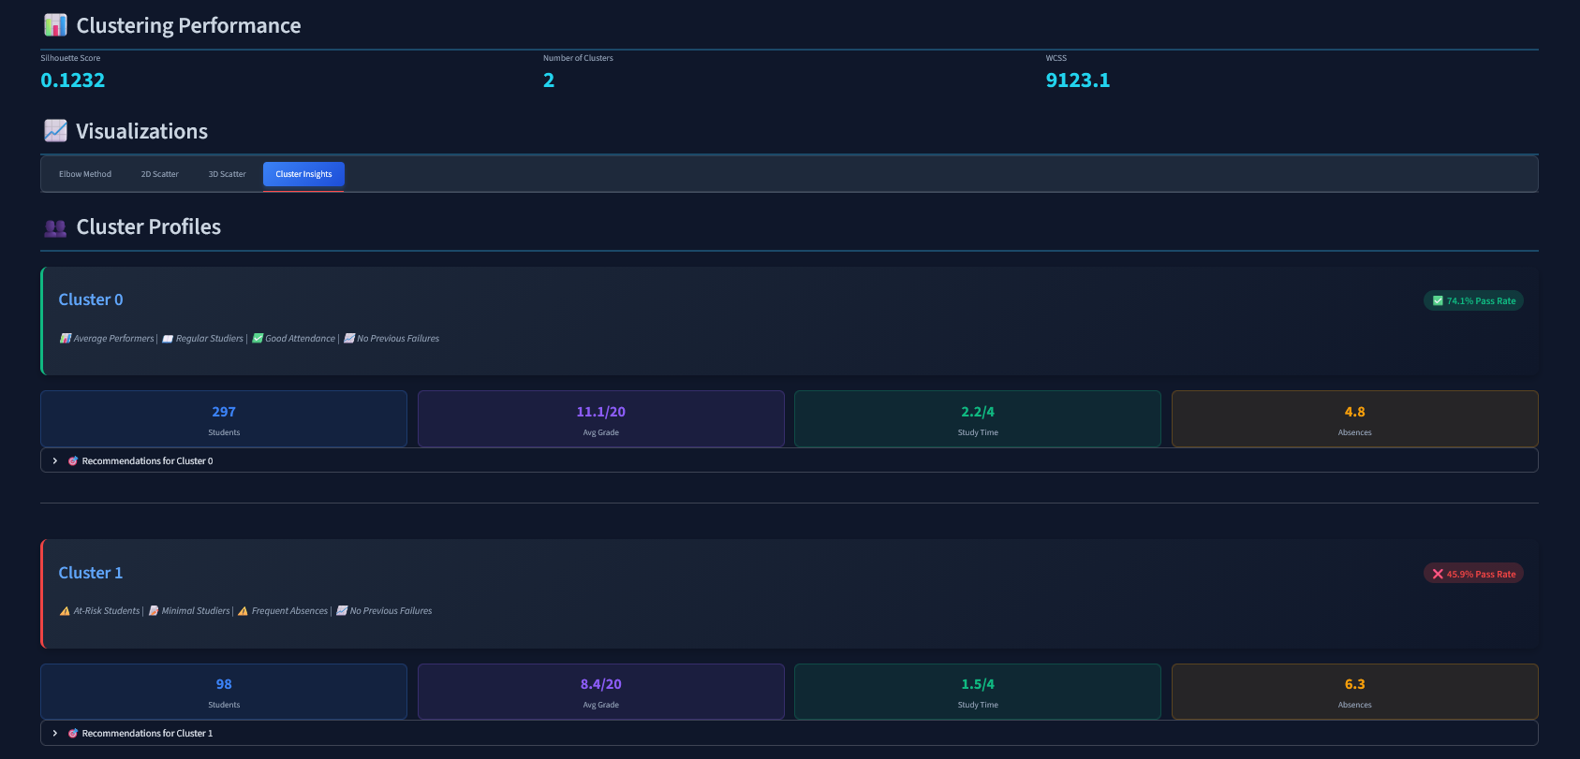

Slide 28
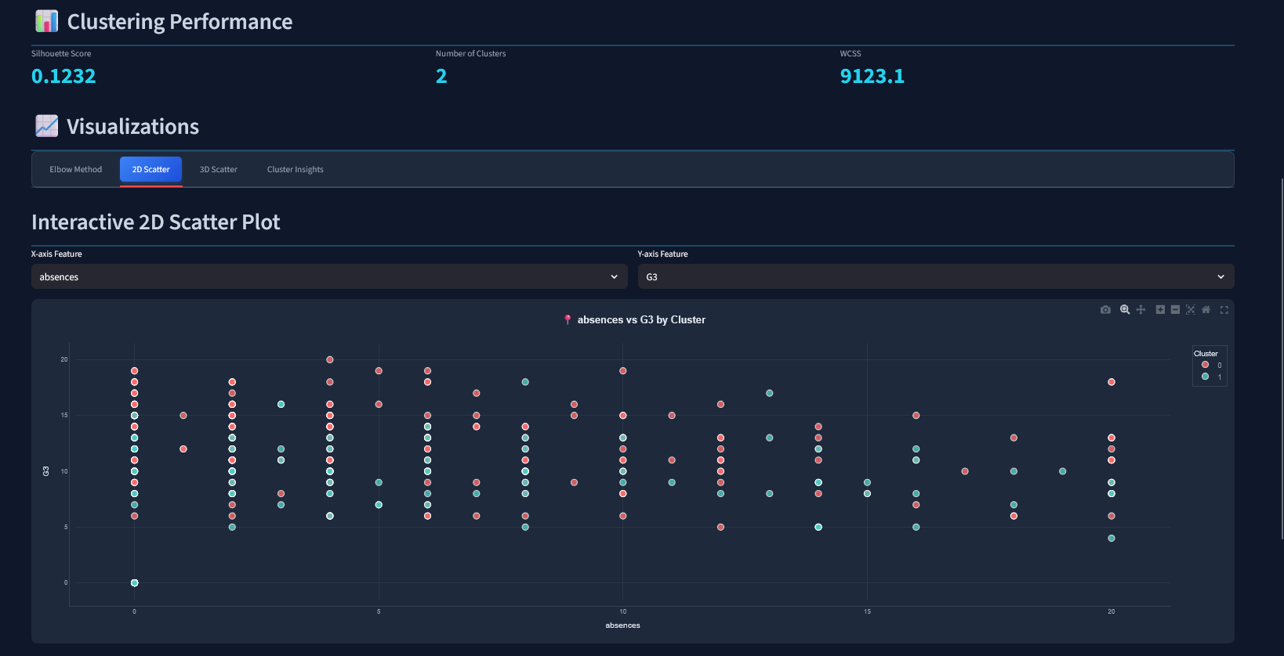

Slide 29
Hybrid Model

Slide 30
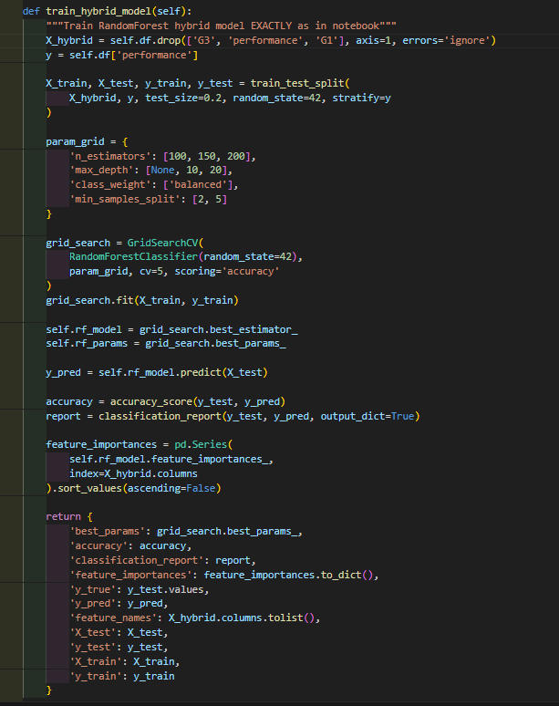
Hybrid Model Methodology
Combine original features with clustering results
Use RandomForest classifier with GridSearchCV
Train on 80% of data, test on 20% with stratification
Include cluster_id and cluster_weight features
Use same hyperparameter grid as notebook
Compare traditional vs hybrid model performanc

Slide 31
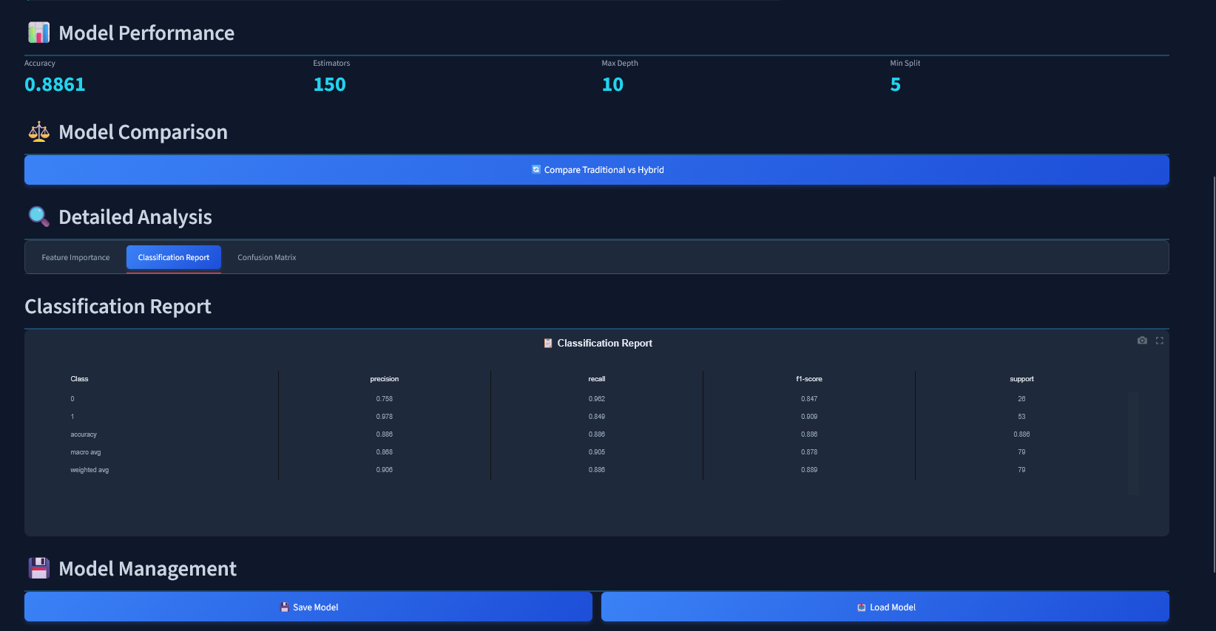
Hybrid Model Performance

Slide 32
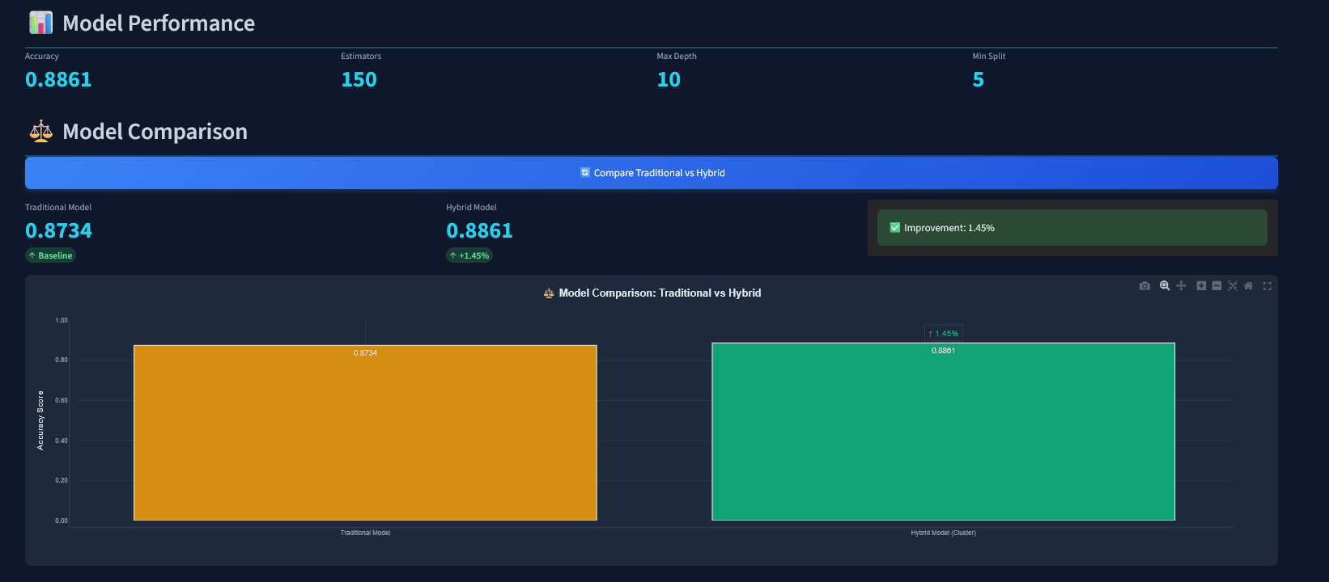
Traditional vs Hybrid

Slide 33
Prediction

Slide 34
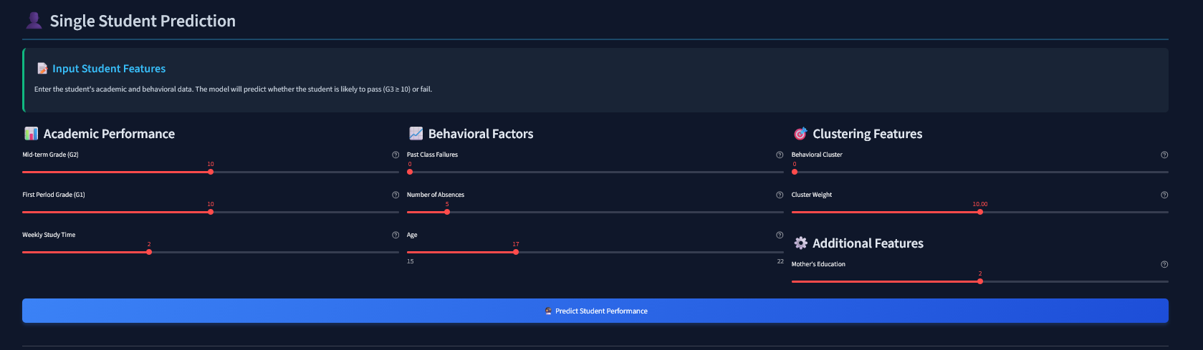
Prediction Settings

Slide 35
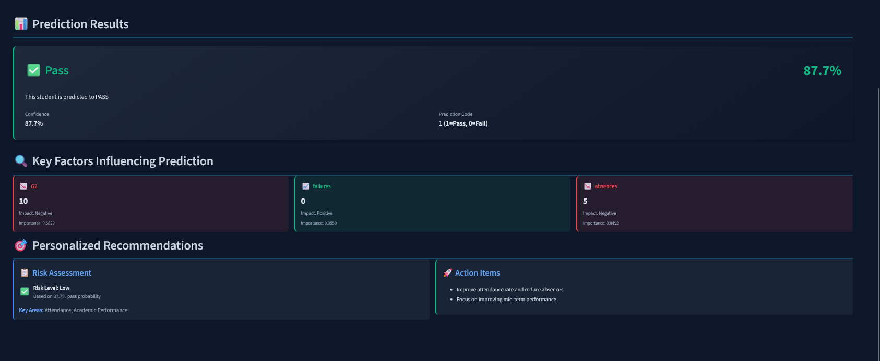
Prediction Results

Slide 36
Clustering Methodology
Exclude grades (G1, G2, G3) for pure behavioral clustering
Standardize features using StandardScaler
Use K-Means with k-means++ initialization
Apply elbow method to determine optimal clusters
Calculate silhouette score for validation
Create cluster_weight feature based on average G3

Slide 37
Thank You

